Slide 1



CSE 470 – Refactoring Code Smells
BRAC UNIVERSITY

Slide 2

What is Refactoring?
A series of small steps, each of which changes the program’s internal structure without changing its external behavior - Martin Fowler
Verify no change in external behavior by
Testing
Using the right tool - IDE
Formal code analysis by tool
Being very, very careful

Slide 3

What if you hear...
We’ll just refactor the code to support logging
Can you refactor the code so that it authenticates against LDAP instead of Database?
We have too much duplicate code, we need to refactor the code to eliminate duplication
This class is too big, we need to refactor it
Caching?

Slide 4
Why do we Refactor?
Helps us deliver more business value faster
Improves the design of our software
Minimizes technical debt
Keep development at speed
To make the software easier to understand
Write for people, not the compiler
To help find bugs
70

Slide 5
Readability
Which code segment is easier to read?
Sample 1
if (date.Before(Summer_Start) || date.After(Summer_End)){
charge = quantity * winterRate + winterServiceCharge;
else
charge = quantity * summerRate;
}
Sample 2
if (IsSummer(date)) {
charge = SummerCharge(quantity);
else
charge = WinterCharge(quantity);
}
72

Slide 6
When should you refactor?
To add new functionality
refactor existing code until you understand it
Like championship
refactor the design to make it simple to add
To find bugs
snooker players we are
setting ourselves up for
refactor to understand the code
For code reviews
our next shot
immediate effect of code review
allows for higher level suggestions
73

Slide 7


The Two Hats
Adding Function
Refactoring
Add new capabilities to the
system
Adds new tests
Get the test working
Does not add any new features
Does not add tests (but may change some)
Restructure the code to remove
redundancy
74

Slide 8
How do we Refactor?
We look for Code-Smells
Things that we suspect are not quite right or will cause us severe pain if we do not fix
77

Slide 9

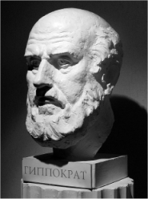
2 Piece of Advice before Refactoring
The Hippocratic Oath
First Do No Harm!
Baby Steps
78

Slide 10
Code Smells?
Code Smells identify frequently occurring design problems in a way that is more specific or targeted than general design guidelines (like “loosely coupled code” or “duplication-free code”). - Joshua K
A code smell is a design that duplicates, complicates, bloats or tightly couples code
79

Slide 11

A short history of Code Smells
If it stinks, change it!
Kent Beck coined the term code smell to signify
something in code that needed to be changed.
80

Slide 12

Common Code Smells
Inappropriate Naming
Comments
Dead Code
Duplicated code
Primitive Obsession
Large Class
Lazy Class
Alternative Class with
Different Interface
Long Method
Long Parameter List
Switch Statements
Speculative Generality
Oddball Solution
Feature Envy
Refused Bequest
Black Sheep
Train Wreck
81

Slide 13

Code Smell - Inappropriate Naming
Names given to variables (fields) and methods should be clear and meaningful.
A variable name should say exactly what it is.
Which is better?
private string s; OR private string salary;
A method should say exactly what it does.
Which is better?
public double calc (double s)
public double calculateFederalTaxes (double salary)
82

Slide 14
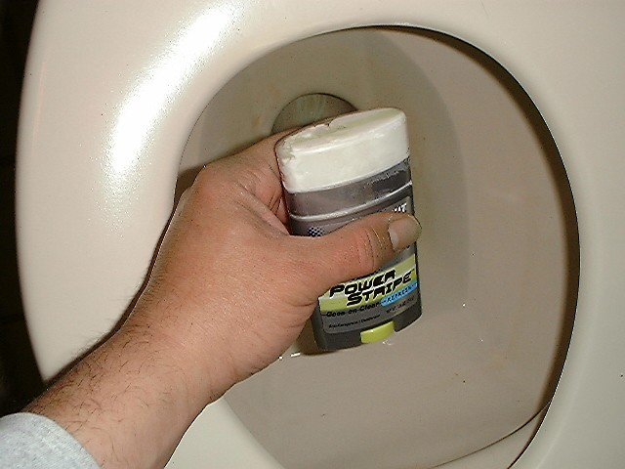
Code Smell - Comments
Comments are often used as deodorant
Comments represent a failure to express an idea in the code. Try to make your code self-documenting or intention-revealing
When you feel like writing a comment, first try "to refactor so that the comment becomes superfluous
Remedies:
Extract Method
Rename Method
Introduce Assertion
public class Example {
public static void main(String[] args) {
int age = 14;
assert age <= 18 : "Cannot Vote";
System.out.println("The voter's age is " + age);
}
}
83

Slide 15
Comment: “Grow the Array” smells
public class MyList
{
int INITIAL_CAPACITY = 10;
bool m_readOnly;
int m_size = 0;
int m_capacity;
string[] m_elements;
public MyList()
{
m_elements = new string[INITIAL_CAPACITY];
m_capacity = INITIAL_CAPACITY;
}
int GetCapacity() {
return m_capacity;
}
}
void AddToList(string element)
{
if (!m_readOnly)
{
int newSize = m_size + 1;
if (newSize > GetCapacity())
{
// grow the array
m_capacity += INITIAL_CAPACITY;
string[] elements2 = new string[m_capacity];
for (int i = 0; i < m_size; i++)
elements2[i] = m_elements[i];
m_elements = elements2;
}
m_elements[m_size++] = element;
}
}
84

Slide 16
Comment Smells Make-over
void AddToList(string element)
{
if (m_readOnly)
return;
if (ShouldGrow())
{
Grow();
}
StoreElement(element);
}
private void Grow()
{
m_capacity += INITIAL_CAPACITY;
string[] elements2 = new string[m_capacity];
for (int i = 0; i < m_size; i++)
elements2[i] = m_elements[i];
m_elements = elements2;
}
private void StoreElement(string element)
{
m_elements[m_size++] = element;
}
private bool ShouldGrow()
{
return (m_size + 1) > GetCapacity();
}
85

Slide 17

Smell: Comments
Rename Method
86

Slide 18
Smell: Comments
Extract Method
void PrintOwning(double amount){
PrintBanner();
// print details
System.Console.Out.WriteLine(“name: “+ name);
System.Console.Out.WriteLine(“amount: “+ amount);
}
87

Slide 19
Smell: Comments
Extract Method
void PrintOwning(double amount){
PrintBanner();
// print details
System.Console.Out.WriteLine(“name: “+ name);
System.Console.Out.WriteLine(“amount: “+ amount);
}
void PrintOwning(double amount){
PrintBanner();
PrintDetails(amount);
}
void PrintDetails(double amount){
System.Console.Out.WriteLine(“name: “+ name);
System.Console.Out.WriteLine(“amount: “+ amount);
}
87

Slide 20
Smell: Comments
Introduce Assertion
88

Slide 21
Smell: Comments
Introduce Assertion
double getExpenseLimit() {
// should have either expense limit or a primary project return (_expenseLimit != NULL_EXPENSE) ? _expenseLimit : _primaryProject.GetMemberExpenseLimit();
}
88

Slide 22

Smell: Comments
Introduce Assertion
double getExpenseLimit() {
// should have either expense limit or a primary project return (_expenseLimit != NULL_EXPENSE) ? _expenseLimit : _primaryProject.GetMemberExpenseLimit();
}
double getExpenseLimit() {
Assert(_expenseLimit != NULL_EXPENSE || _primaryProject != null, “Both Expense Limit and Primary Project must not be null”);
return (_expenseLimit != NULL_EXPENSE) ? _expenseLimit :
_primaryProject.GetMemberExpenseLimit();
}
88

Slide 23
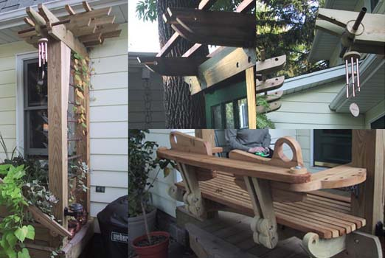
Code Smell - Long Method
A method is long when it is too hard to quickly comprehend.
Long methods tend to hide behavior that ought to be shared, which leads to duplicated code in other methods or classes.
Good OO code is easiest to understand and maintain with shorter methods
with good names
Remedies:
Extract Method
Replace Temp with Query
Introduce Parameter Object
Preserve Whole Object
Decompose Conditional
89

Slide 24
Long Method Example
private String toStringHelper(StringBuffer result)
{
result.append("<");
result.append(name);
result.append(attributes.toString());
result.append(">");
if (!value.equals(""))
result.append(value);
Iterator it = children().iterator();
while (it.hasNext())
{
TagNode node = (TagNode)it.next();
node.toStringHelper(result);
}
result.append("</");
result.append(name);
result.append(">");
return result.toString();
}
Example Html tag:
<name> Jannet Jhonson </name>
90

Slide 25
Long Method Makeover (Extract Method)
private String toStringHelper(StringBuffer result)
{
writeOpenTagTo(result);
writeValueTo(result);
writeChildrenTo(result);
writeEndTagTo(result);
return result.toString();
}
private void writeOpenTagTo(StringBuffer result)
{
result.append("<");
result.append(name);
result.append(attributes.toString());
result.append(">");
}
private void writeEndTagTo(StringBuffer result)
{
result.append("</");
result.append(name);
result.append(">");
}
private void writeValueTo(StringBuffer result)
{
if (!value.equals(""))
result.append(value);
}
private void writeChildrenTo(StringBuffer result)
{
Iterator it = children().iterator();
while (it.hasNext())
{
TagNode node = (TagNode)it.next();
node.toStringHelper(result);
}
}
91

Slide 26
Smell: Long Method
Replace Temp with Query
Method1(){
double basePrice = _quanity * _itemPrice; if(basePrice > 1000) {
return basePrice * 0.95
}
else{
return basePrice*0.98
}
}
What if the basePrice calculation equation changes ??
-- We would need to change two lines in the code
Method2(){
double basePrice = _quanity * _itemPrice;
return basePrice + 100;
}
92

Slide 27

Smell: Long Method
Replace Temp with Query
Method1(){
double basePrice = _quanity * _itemPrice; if(basePrice > 1000) {
return basePrice * 0.95
}
else{
return basePrice*0.98
}
}
Method1(){
if(getBasePrice() > 1000) {
return getBasePrice() * 0.95;
}
else {
return getBasePrice() * 0.98;
}
}
double getBasePrice() {
return _quanitiy * itemPrice;
}
92

Slide 28
Smell: Long Method
Replace Temp with Query
Method2(){
double basePrice = _quanity * _itemPrice;
return basePrice + 100;
}
double getBasePrice() {
return _quanitiy * itemPrice;
}
Method2(){
return getBasePrice() + 100;
}
92

Slide 29
Smell: Long Method
Introduce Parameter Object
int MethodTooManyParameter (Date start, Date end, int value, string month, string yearStart, string yearEnd)
{
// method body
}
94

Slide 30
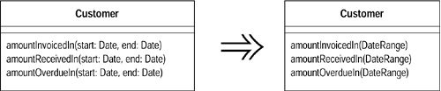
Smell: Long Method
Introduce Parameter Object
Class DateRange{
Date start;
Date end;
}
94

Slide 31
Smell: Long Method
Preserve Whole Object
int low = daysTempRange.startDate;
int high = daysTempRange.endDate;
withinPlan = plan.withinRange(low, high);
class DateRange {
Date startDate;
Date endDate;
Date remindDate;
}
withinPlan = plan.withinRange(daysTempRange);
SomeObject withinRange(DateRange daysRange) {
low = daysRange.startDate;
high = daysRange.endDate;
//code as before
}
95

Slide 32
Smell: Long Method
Decompose Conditional
You have a complicated conditional (if-then-else) statement.
Extract methods from the condition, then part, and else parts.
if (date.before (SUMMER_START) || date.after(SUMMER_END))
charge = quantity * _winterRate + _winterServiceCharge;
else charge = quantity * _summerRate;
if (notSummer(date))
charge = winterCharge(quantity);
else charge = summerCharge (quantity)
97

Slide 33
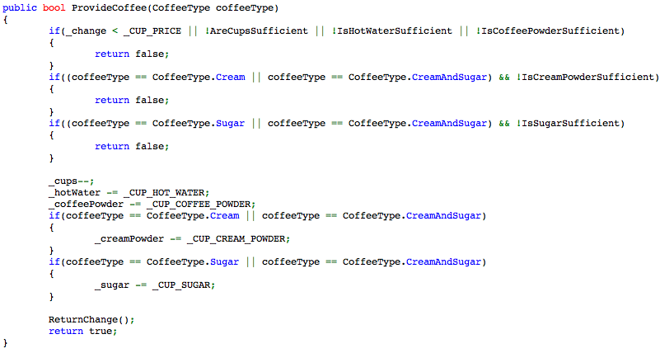
Example of Conditional Complexity
98

Slide 34
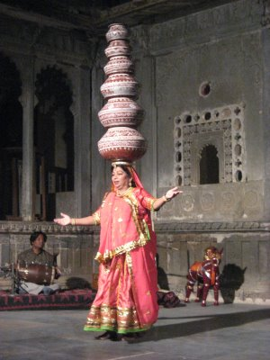
Code Smell- Long Parameter List
Methods that take too many parameters produce client code that is awkward and difficult to work with.
Remedies:
Introduce Parameter Object
Replace Parameter with Method
Preserve Whole Object
174

Slide 35
Example
private void createUserInGroup() {
GroupManager groupManager = new GroupManager();
Group group = groupManager.create(TEST_GROUP, false, GroupProfile.UNLIMITED_LICENSES, "",
GroupProfile.ONE_YEAR, null);
user = userManager.create(USER_NAME, group, USER_NAME, "jack", USER_NAME, LANGUAGE, false, false, new Date(),
"blah", new Date());
}
175

Slide 36
Smell: Long Parameter List
Introduce Parameter Object
Customer
AmoutInvoicedIn(Date start, Date end)
AmoutRecivedIn(Date start, Date end)
AmoutOverdueIn(Date start, Date end)
176

Slide 37

Smell: Long Parameter List
Introduce Parameter Object
Customer
AmoutInvoicedIn(Date start, Date end)
AmoutRecivedIn(Date start, Date end)
AmoutOverdueIn(Date start, Date end)
Customer
AmoutInvoicedIn(DateRange range)
AmoutRecivedIn(DateRange range)
AmoutOverdueIn(DateRange range)
176

Slide 38
Smell: Long Parameter List
Replace Parameter with Method Call
int basePrice = quantity * itemPrice;
double seasonDiscount = this.getSeasonalDiscount();
double fees = this.getFees();
double finalPrice = discountedPrice(basePrice, seasonDiscount, fees);
int basePrice = quantity * itemPrice;
double finalPrice = discountedPrice(basePrice);
double discountedPrice(int basePrice) {
double seasonDiscount = this.getSeasonalDiscount();
double fees = this.getFees();
//code as before
}
177

Slide 39
Smell: Long Parameter List
Replace Parameter with Method Call
public double getPrice() {
int basePrice = _quantity * _itemPrice;
int discountLevel;
if (_quantity > 100)
discountLevel = 2;
else
discountLevel = 1;
double finalPrice = discountedPrice (basePrice, discountLevel);
return finalPrice;
}
private double discountedPrice (int basePrice, int discountLevel) {
if (discountLevel == 2)
return basePrice * 0.1;
else
return basePrice * 0.05;
}
177

Slide 40
Smell: Long Parameter List
Replace Parameter with Method Call
public double getPrice() {
int basePrice = _quantity * _itemPrice;
int discountLevel = getDiscountLevel();
double finalPrice = discountedPrice (basePrice, discountLevel);
return finalPrice;
}
private int getDiscountLevel() {
if (_quantity > 100) return 2;
else return 1;
}
private double discountedPrice (int basePrice, int discountLevel) {
if (discountLevel == 2) return basePrice * 0.1;
else return basePrice * 0.05;
}
177

Slide 41
Smell: Long Parameter List
Replace Parameter with Method Call
public double getPrice() {
int basePrice = _quantity * _itemPrice;
double finalPrice = discountedPrice (basePrice);
return finalPrice;
}
private double discountedPrice (int basePrice) {
if (getDiscountLevel() == 2) return basePrice * 0.1;
else return basePrice * 0.05;
}
177

Slide 42
Smell: Long Method
Preserve Whole Object
int low = daysTempRange.startDate;
int high = daysTempRange.endDate;
withinPlan = plan.withinRange(low, high);
class DateRange {
Date startDate;
Date endDate;
Date remindDate;
}
withinPlan = plan.withinRange(daysTempRange);
SomeObject withinRange(DateRange daysRange) {
low = daysRange.startDate;
high = daysRange.endDate;
//code as before
}
95

Slide 43

Feature Envy
A method that seems more interested in some other class than the one it is in.
Data and behavior that acts on that data belong together. When a method
makes too many calls to other classes to obtain data or functionality, Feature
Envy is in the air.
Remedies:
Move Field
Move Method
Extract Method
178

Slide 44
Example
public class CapitalStrategy{
double capital(Loan loan)
{
if (loan.getExpiry() == NO_DATE && loan.getMaturity() != NO_DATE)
return loan.getCommitmentAmount() * loan.duration() * loan.riskFactor();
if (loan.getExpiry() != NO_DATE && loan.getMaturity() == NO_DATE)
{
if (loan.getUnusedPercentage() != 1.0)
return loan.getCommitmentAmount() * loan.getUnusedPercentage() * loan.duration() * loan.riskFactor();
else
return (loan.outstandingRiskAmount() * loan.duration() * loan.riskFactor()) +
(loan.unusedRiskAmount() * loan.duration() * loan.unusedRiskFactor());
}
return 0.0;
}
}
179

Slide 45
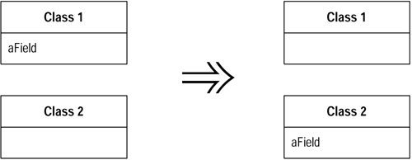
Smell: Feature Envy
Move Field
180

Slide 46
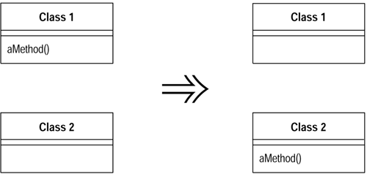
Smell: Feature Envy
Move Method
181

Slide 47
Example
public class CapitalStrategy{
double capital(Loan loan)
{
if (loan.getExpiry() == NO_DATE && loan.getMaturity() != NO_DATE)
return loan.getCommitmentAmount() * loan.duration() * loan.riskFactor();
if (loan.getExpiry() != NO_DATE && loan.getMaturity() == NO_DATE)
{
if (loan.getUnusedPercentage() != 1.0)
return loan.getCommitmentAmount() * loan.getUnusedPercentage() * loan.duration() * loan.riskFactor();
else
return (loan.outstandingRiskAmount() * loan.duration() * loan.riskFactor()) +
(loan.unusedRiskAmount() * loan.duration() * loan.unusedRiskFactor());
}
return 0.0;
}
}
179

Slide 48
Example
public class Loan{
double capitalForCapitalStrategy()
{
if (getExpiry() == NO_DATE && getMaturity() != NO_DATE)
return getCommitmentAmount() * duration() * riskFactor();
if (getExpiry() != NO_DATE && getMaturity() == NO_DATE)
{
if getUnusedPercentage() != 1.0)
return getCommitmentAmount() * getUnusedPercentage() * duration() * riskFactor();
else
return (outstandingRiskAmount() * duration() * riskFactor()) +
(unusedRiskAmount() * duration() * unusedRiskFactor());
}
return 0.0;
}
}
179

Slide 49
Example
public class Loan{
double capitalForCapitalStrategy() {
…
...
}
}
public class CapitalStrategy{
double capital(Loan loan) {
return loan.capitalForCapitalStrategy();
}
}
179

Slide 50
Duplicated Code
The most pervasive and pungent smell in software
There is obvious or blatant duplication
Such as copy and paste
There are subtle or non-obvious duplications
Similar algorithms
Remedies
Extract Method
Pull Up Field
Form Template Method
Substitute Algorithm
122

Slide 51
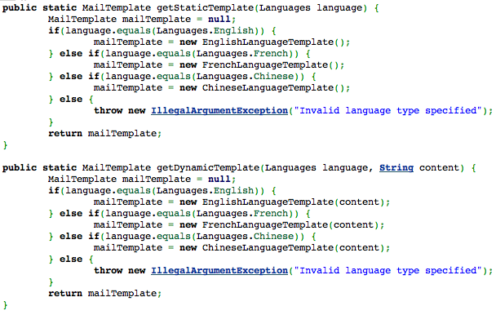
Ctl+C Ctl+V Pattern
123

Slide 52
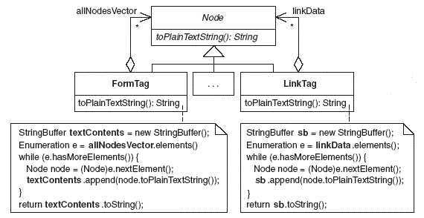
Example Of Obvious Duplication
124

Slide 53
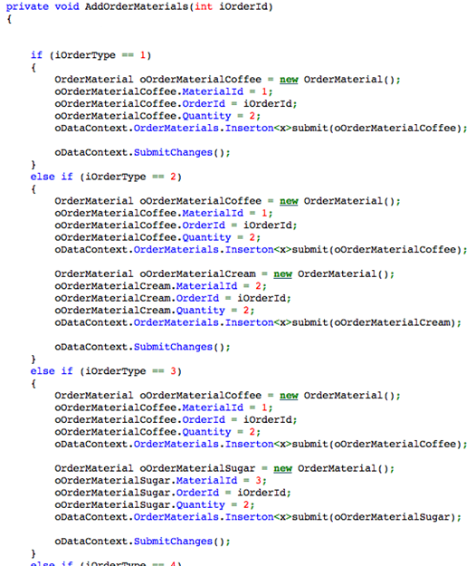
126

Slide 54
Levels of Duplication
127

Slide 55
Literal Duplication
Same for loop in 2 places
128

Slide 56
Semantic Duplication
for(int i : asList(1,3,5,10,15)) stack.push(i);
v/s
for(int i=0;i<5;i++){
stack.push(asList(i));
}
1stLevel - For and For Each Loop
2ndLevel - Loop v/s Lines repeated
stack.push(1); stack.push(3); stack.push(5); stack.push(10); stack.push(15);
v/s
for(int i : asList(1,3,5,10,15)) stack.push(i);
129

Slide 57
Data Duplication
Same constant declared in 2 classes (test and production)
130

Slide 58
Conceptual Duplication
2 Algorithm to Sort elements (Bubble sort and Quick sort)
132

Slide 59
Logical Steps - Duplication
Same set of steps repeat in different scenarios.
Ex: Same set of validations in various points in your applications
134

Slide 60
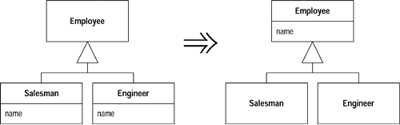
Smell: Duplicate Code
Pull Up Field
136

Slide 61
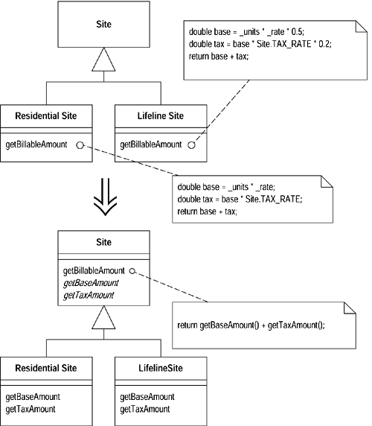
Smell: Duplicate Code
Form Template Method
137

Slide 62
Smell: Duplicate Code
Substitute Algorithm
String foundPerson(String[] people){
for (int i = 0; i < people.length; i++) {
if (people[i].equals ("Don")){
return "Don";
}
if (people[i].equals ("John")){
return "John";
}
if (people[i].equals ("Kent")){
return "Kent";
}
}
return "";
}
138

Slide 63
Smell: Duplicate Code
Substitute Algorithm
String foundPerson(String[] people){
for (int i = 0; i < people.length; i++) {
if (people[i].equals ("Don")){
return "Don";
}
if (people[i].equals ("John")){
return "John";
}
if (people[i].equals ("Kent")){
return "Kent";
}
}
return "";
}
String foundPerson(String[] people){
List candidates = Arrays.asList(new String[] {"Don", "John", "Kent"});
for (String person : people)
if (candidates.contains(person))
return person;
return "";
}
138

Slide 64

Refused Bequest
This rather potent odor results when subclasses inherit code that they don’t want. In some cases, a subclass may “refuse the bequest” by providing a do-nothing implementation of an inherited method.
Remedies
Push Down Field
Push Down Method
116

Slide 65
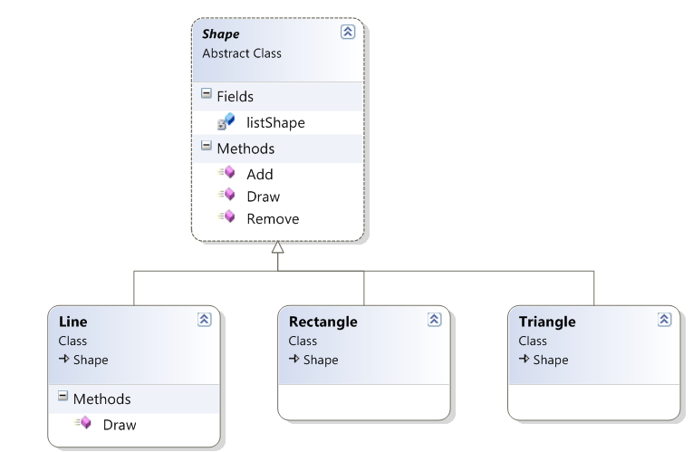
Smell: Refused Bequest
Example of Refused Bequest
Salesman
104

Slide 66
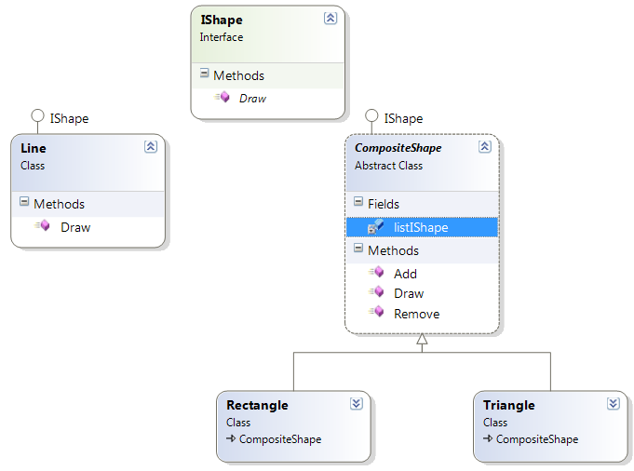
Smell: Refused Bequest
Refused Bequest Make Over
104

Slide 67
References
[F] Fowler, Martin. Refactoring: Improving the Design of Existing Code.
Boston, MA: Addison-Wesley, 2000
[K] Kerievsky, Joshua. Refactoring to Patterns. Boston, MA: Addison-Wesley,
2005
187

